Slide 1
Chapter 8: DHCP
Instructor Materials
CCNA Routing and Switching
Routing and Switching Essentials v6.0
Notes:
Cisco Networking Academy Program
Routing and switching Essentials v6.0
Chapter 8: DHCP

Slide 2
Instructor Materials – Chapter 8 Planning Guide
This PowerPoint deck is divided in two parts:
Instructor Planning Guide
Information to help you become familiar with the chapter
Teaching aids
Instructor Class Presentation
Optional slides that you can use in the classroom
Begins on slide # 12
Note: Remove the Planning Guide from this presentation before sharing with anyone.
Notes:
2

Slide 3
Chapter 8: DHCP
Routing and Switching Essentials v6.0 Planning Guide
Notes:
Cisco Networking Academy Program
Routing and Switching Essentials v6.0
Chapter 8: DHCP

Slide 4
Chapter 8: Activities
What activities are associated with this chapter?
Page # | Activity Type | Activity Name | Optional?
8.1.1.5 | Interactive Activity | Identify the Steps in DHCPv4 Operation | Recommended
8.1.2.1 | Syntax Checker | Configuring a DCHPv4 Server | Recommended
8.1.2.3 | Syntax Checker | Configure DCHPv4 Relay | Recommended
8.1.2.4 | Lab | Configuring Basic DHCPv4 on a Router | Recommended
8.1.2.5 | Lab | Configuring Basic DHCPv4 on a Switch | Optional
8.1.3.1 | Syntax Checker | Configuring a Router as DHCP Client | Recommended
8.1.3.3 | Packet Tracer | Configuring DHCPv4 Using Cisco IOS | Recommended
8.1.4.4 | Lab | Troubleshooting DCHPv4 | Optional
8.2.1.8 | Interactive Activity | Identify the Steps in DHCPv6 Operation | Recommended
8.2.2.3 | Syntax Checker | Configuring and Verifying Stateless DHCPv6 | Recommended
The password used in the Packet Tracer activities in this chapter is: PT_ccna5
Notes:
4

Slide 5
Chapter 8: Activities (Cont.)
What activities are associated with this chapter?
Page # | Activity Type | Activity Name | Optional?
8.2.3.3 | Syntax Checker | Configuring and Verifying Stateful DHCPv6 | Recommended
8.2.3.4 | Syntax Checker | Configuring a Router as a DHCPv6 Relay Agent | Recommended
8.2.3.5 | Lab | Configuring Stateless and Stateful DHCPv6 | Recommended
8.2.4.4 | Lab | Troubleshooting DHCPv6 | Recommended
8.3.1.1 | Class Activity | IoE and DHCP | Optional
8.3.1.2 | Packet Tracer | Skills Integration Challenge | Recommended
The password used in the Packet Tracer activities in this chapter is: PT_ccna5
Notes:
5

Slide 6
Chapter 8: Assessment
Students should complete Chapter 8, “Assessment” after completing Chapter 8.
Quizzes, labs, Packet Tracers and other activities can be used to informally assess student progress.
Notes:
6

Slide 7
Chapter 8: Best Practices
Prior to teaching Chapter 8, the instructor should:
Complete Chapter 8, “Assessment.”
The objectives of this chapter are:
Explain how DHCPv4 operates in a small- to medium-sized business network.
Configure a router as a DHCPv4 server.
Configure a router as a DHCPv4 client.
Troubleshoot a DHCP configuration for IPv4 in a switched network.
Explain the operation of DHCPv6.
Configure stateless DHCPv6 for a small to medium-sized business.
Configure stateful DHCPv6 for a small to medium-sized business.
Troubleshoot a DHCP configuration for IPv6 in a switched network.
Notes:
7

Slide 8
Chapter 8: Best Practices (Cont.)
8.1
The instructor should ensure this chapter becomes as hands-on as possible.
Discuss the advantages of using DHCP in a large network.
Point out the importance of knowing the DHCP operation steps - DHCP Discover, DHCP Offer, DHCP Request, DHCP Acknowledgment ---DORA
Use activity 8.1.1.5 to reinforce student’s understanding
Demonstrate configuration of DHCP using Packet Tracer.
Use Packet Tracer to recreate the topology from 8.1.2.3. Demonstrate DHCP configuration and DHCP relay, configuring an ip helper address, using that topology.
Use the same topology to verify DHCP configuration
Inject some problems to demonstrate troubleshooting DHCP.
Recommend that students complete Labs 8.1.2.4, 8.1.2.5 and 8.1.3.3
Notes:
8

Slide 9
Chapter 8: Best Practices (Cont.)
8.2
Discuss the assignment of IPv6 addresses using SLAAC and DHCPv6.
Explain SLAAC operation and Duplicate Address Detection.
Point out the 3 addressing options for an IPv6 device and how to configure (using Packet Tracer if possible):
SLAAC (Router Advertisement only) Default
Stateless DHCPv6 (Router Advertisement and DHCPv6)
Stateful DHCPv6 (DHCPv6 only)
Recreate the topology in 8.2.3.4 in Packet Tracer to demonstrate configuration, verification and troubleshooting of Stateful DHCPv6.
Recommend that students complete labs 8.2.3.5 and 8.2.4.4.
Notes:
9

Slide 10
Chapter 8: Additional Help
For additional help with teaching strategies, including lesson plans, analogies for difficult concepts, and discussion topics, visit the CCNA Community at: https://www.netacad.com/group/communities/community-home
Best practices from around the world for teaching CCNA Routing and Switching. https://www.netacad.com/group/communities/ccna
If you have lesson plans or resources that you would like to share, upload them to the CCNA Community in order to help other instructors.
Students can enroll in Introduction to Packet Tracer (self-paced)
Notes:
10

Slide 12
Chapter 8: DHCP
CCNA Routing and Switching
Routing and Switching Essentials v6.0
Notes:
Cisco Networking Academy Program
Routing and Switching Essentials v6.0
Chapter 8: DHCP

Slide 13
Chapter 8 - Sections & Objectives
8.1 DHCPv4
Implement DHCPv4 to operate across multiple LANs in a small to medium-sized business network.
Explain how DHCPv4 operates in a small- to medium-sized business network.
Configure a router as a DHCPv4 server.
Configure a router as a DHCPv4 client.
Troubleshoot a DHCP configuration for IPv4 in a switched network.
8.2 DHCPv6
Implement DHCPv6 to operate across multiple LANs in a small to medium-sized business network.
Explain the operation of DHCPv6.
Configure stateless DHCPv6 for a small to medium-sized business.
Configure stateful DHCPv6 for a small to medium-sized business.
Troubleshoot a DHCP configuration for IPv6 in a switched network.
Notes:
13
Cisco Networking Academy Program
Routing and Switching Essentials v6.0
Chapter 8: DHCP

Slide 14
8.1 DHCPv4
Notes:
8 - DHCP
8.1 – DHCPv4

Slide 15
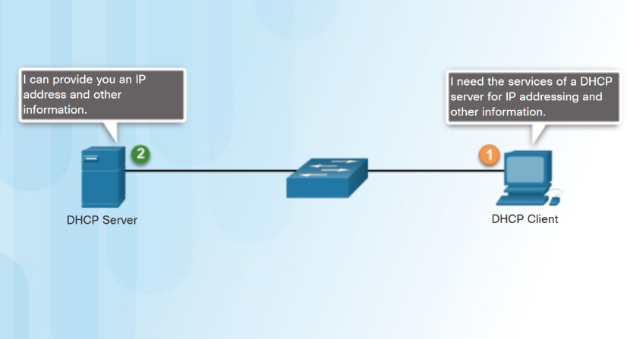
DHCPv4 Operation Introducing DHCPv4
DHCPv4 assigns IPv4 addresses and other network configuration information dynamically.
A dedicated DHCPv4 server is scalable and relatively easy to manage.
A Cisco router can be configured to provide DHCPv4 services in a small network.
Notes:
8.1 – DHCPv4
8.1.1 – DHCPv4 Operation
8.1.1.1 – Introducing DHCPv4

Slide 16
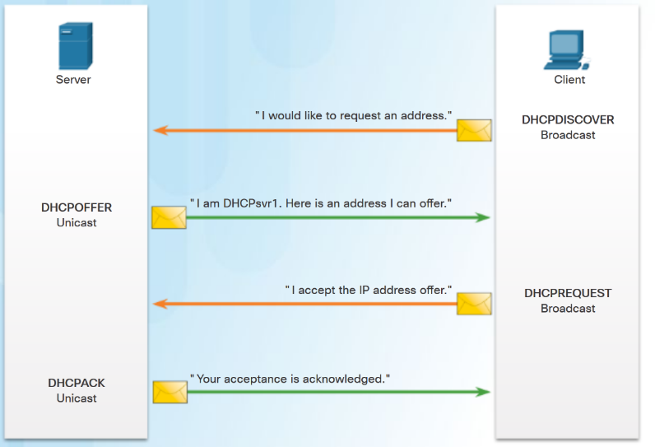
DHCPv4 Operation DHCPv4 Operation
Four step process for a client to obtain a lease:
1. DHCP Discover (DHCPDISCOVER) - client uses Layer 2 and Layer 3 broadcast addresses to find a DHCP server.
2. DHCP Offer (DHCPOFFER) - DHCPv4 server sends the binding DHCPOFFER message to the requesting client as a unicast.
3. DHCP Request (DHCPREQUEST) – the client sends back a broadcast DHCPREQUEST in response to the servers offer.
4. DHCP Acknowledgment (DHCPACK) – the server replies with a unicast DHCPACK message.
Notes:
8.1 – DHCPv4
8.1.1 – DHCPv4 Operation
8.1.1.2 – DHCPv4 Operation

Slide 17
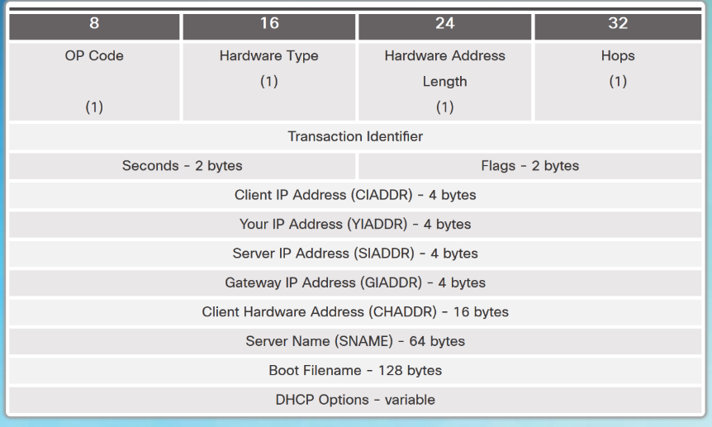
DHCPv4 Operation DHCPv4 Message Format
DHCPv4 messages:
If sent from the client, use UDP source port 68 and destination port 67.
If sent from the server, use UDP source port 67 and destination port 68.
Format and fields of a DHCPv4 Message
Notes:
8.1 – DHCPv4
8.1.1 – DHCPv4 Operation
8.1.1.3 – DHCPv4 Message Format

Slide 18
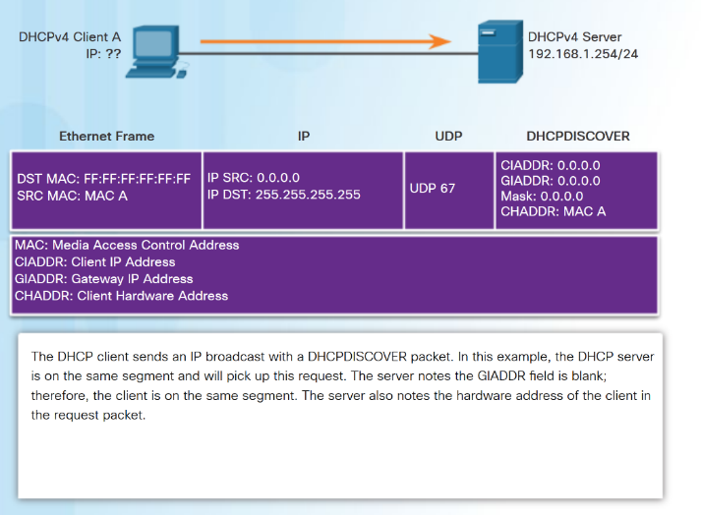
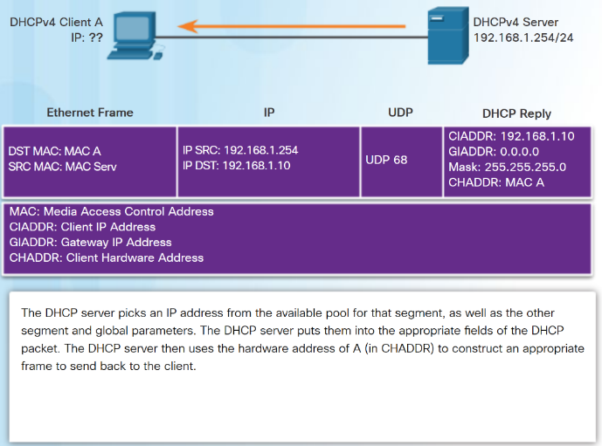
DHCPv4 Operation DHCPv4 Discover and Offer Messages
Notes:
8.1 – DHCPv4
8.1.1 – DHCPv4 Operation
8.1.1.4 – DHCPv4 Discover and Offer Messages

Slide 19
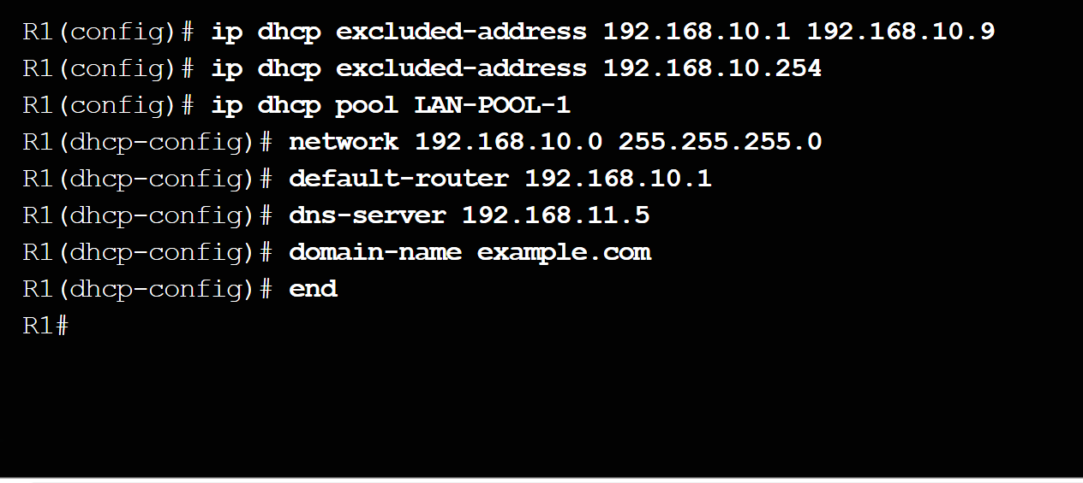
Configuring a Basic DHCPv4 Server Configuring a Basic DHCPv4 Server
Configuring a Cisco router as a DHCPv4 server:
Excluding IPv4 Addresses – ip dhcp excluded-address can exclude a single address or a range of addresses from being assigned.
Configuring a DHCPv4 Pool - ip dhcp pool pool-name command creates a pool with the specified name and puts the router in DHCPv4 configuration mode.
Address pool assigned using network command.
Default gateway assigned using default-router command.
Other commands are optional.
Notes:
8.1 – DHCPv4
8.1.2 – Configuring a Basic DHCPv4 Server
8.1.2.1 – Configuring a Basic DHCPv4 Server

Slide 20
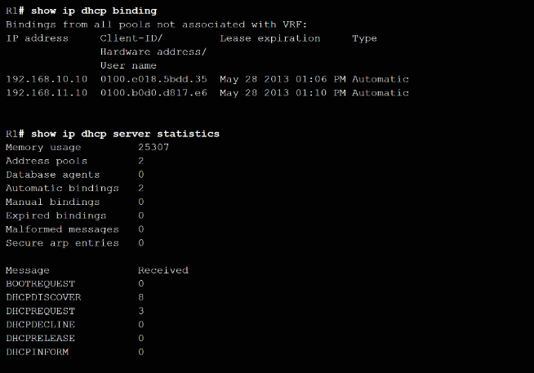
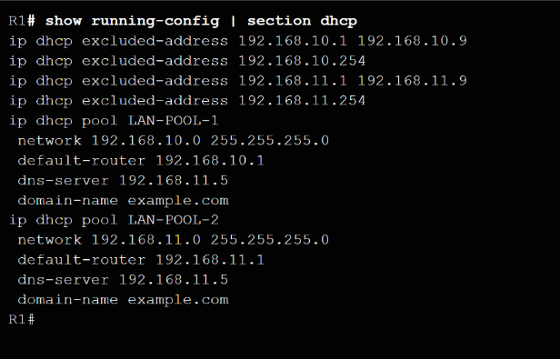
Configuring a Basic DHCPv4 Server Verifying DHCPv4
Verify DHCPv4 configuration using the show running-config |section dhcp command.
Verify the operation of DHCPv4 using the show ip dhcp binding command.
Verify that messages are being received or sent by the router using the show ip dhcp server statistics command.
Notes:
8.1 – DHCPv4
8.1.2 – Configuring a Basic DHCPv4 Server
8.1.2.2 – Verifying DHCPv4

Slide 21
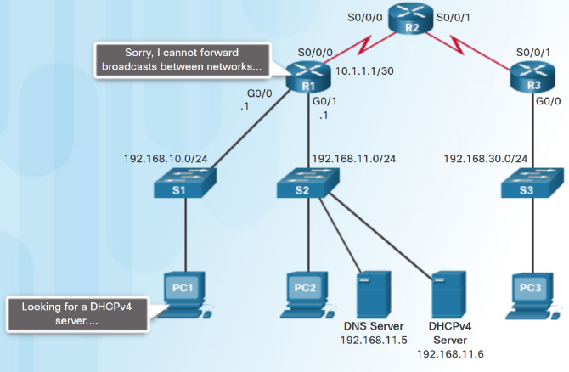
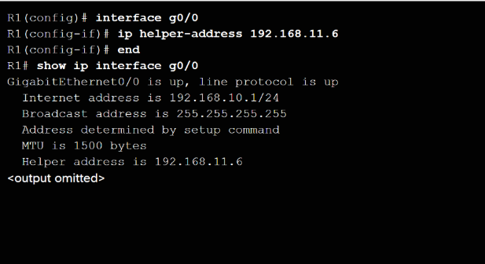
Configuring a Basic DHCPv4 Server DHCPv4 Relay
DHCPDISCOVER messages are sent as broadcast messages.
Routers do not forward broadcasts.
A Cisco IOS helper address is configured so that the router acts as a relay agent forwarding the message to the DHCPv4 server.
Notes:
8.1 – DHCPv4
8.1.2 – Configuring a Basic DHCPv4 Server
8.1.2.3 – DHCPv4 Relay

Slide 22
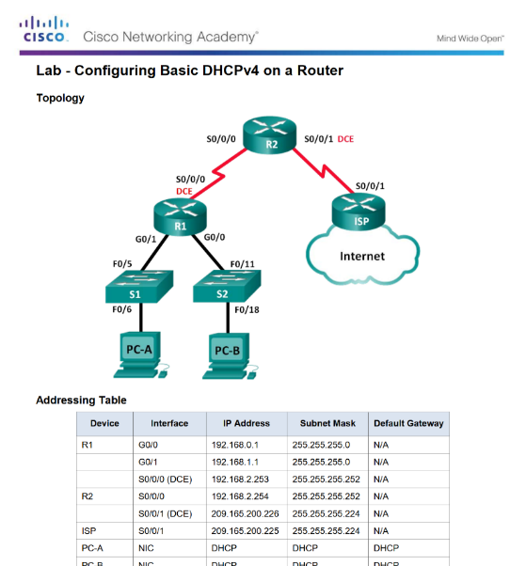
Configuring a Basic DHCPv4 Server Lab - Configuring Basic DHCPv4 on a Router
Notes:
8.1 – DHCPv4
8.1.2 – Configuring a Basic DHCPv4 Server
8.1.2.4 – Lab - Configuring Basic DHCPv4 on a Router

Slide 23
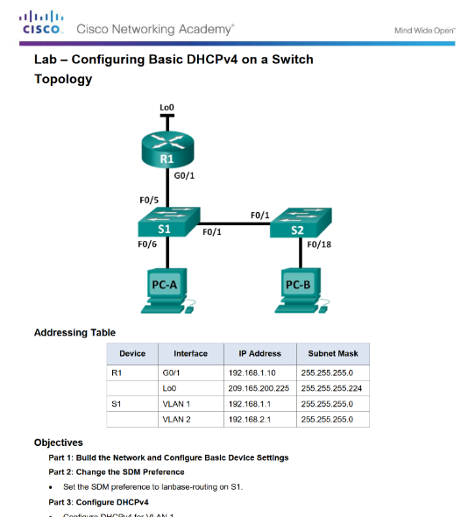
Configuring a Basic DHCPv4 Server Lab - Configuring Basic DHCPv4 on a Switch
Notes:
8.1 – DHCPv4
8.1.2 – Configuring a Basic DHCPv4 Server
8.1.2.5 – Lab - Configuring Basic DHCPv4 on a Switch

Slide 24
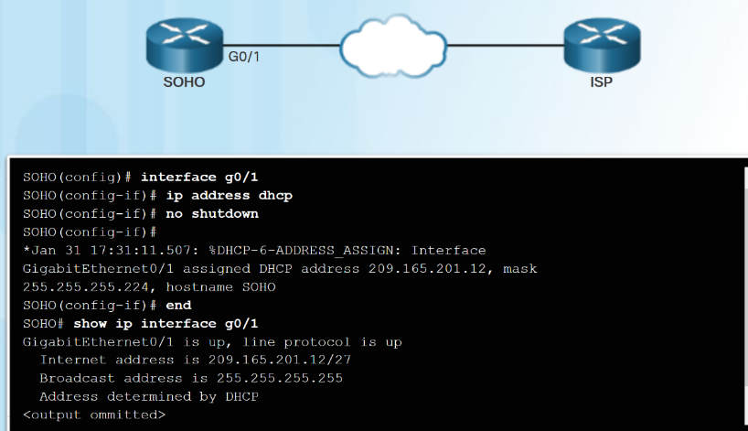
Configuring DHCPv4 Client Configuring a Router as DHCPv4 Client
Small office/home office (SOHO) and branch sites often have to be configured as DHCPv4 clients.
Use the ip address dhcp interface configuration mode command.
Notes:
8.1 – DHCPv4
8.1.3 – Configure DHCPv4 Client
8.1.3.1 – Configuring a Router as DHCPv4 Client

Slide 25
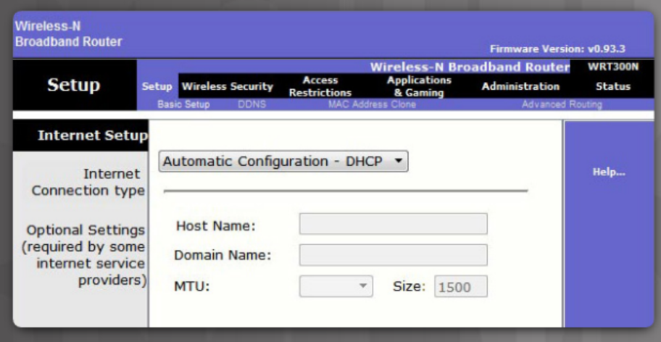
Configuring DHCPv4 Client Configuring a Wireless Router as a DHCPv4 Client
Wireless routers are set to receive IPv4 addressing information automatically from the ISP.
Notes:
8.1 – DHCPv4
8.1.3 – Configure DHCPv4 Client
8.1.3.2 – Configuring a Wireless Router as a DHCPv4 Client

Slide 26
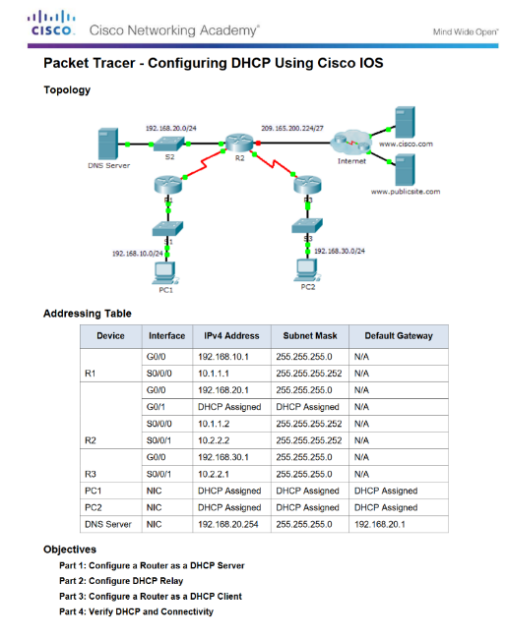
Configuring DHCPv4 Client Packet Tracer - Configuring DHCPv4 Using Cisco IOS
Notes:
8.1 – DHCPv4
8.1.3 – Configure DHCPv4 Client
8.1.3.3 – Packet Tracer - Configuring DHCPv4 Using Cisco IOS

Slide 27
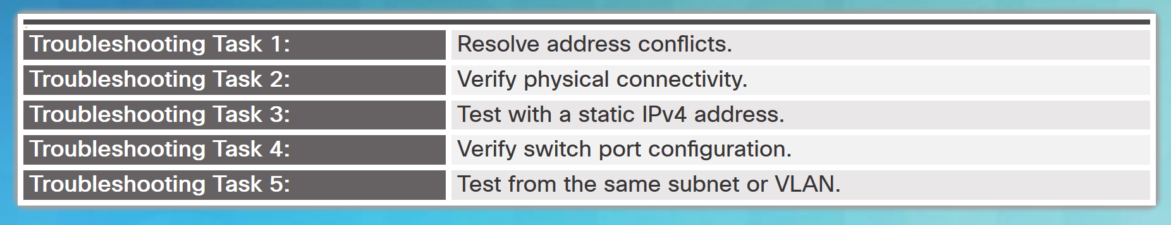
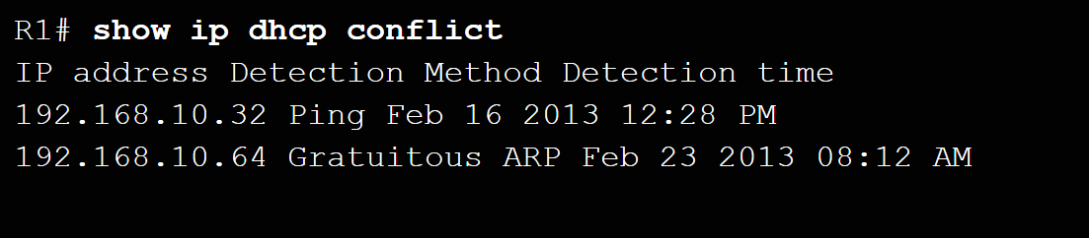
Troubleshoot DHCPv4 Troubleshooting Tasks
Notes:
8.1 – DHCPv4
8.1.4 – Troubleshoot DHCPv4
8.1.4.1 – Troubleshooting Tasks

Slide 28
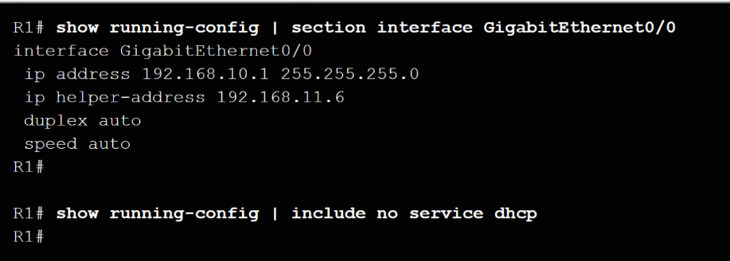
Troubleshoot DHCPv4 Verify Router DHCPv4 Configuration
Verify DHCPv4 Relay - use show running-config command to verify that the ip helper address is configured.
Verify DHCPv4 configuration - use the show running-config | include no service dhcp command to verify dhcp is enabled because there is no match for the no service dhcp.
Notes:
8.1 – DHCPv4
8.1.4 – Troubleshoot DHCPv4
8.1.4.2 – Verify Router DHCPv4 Configuration

Slide 29
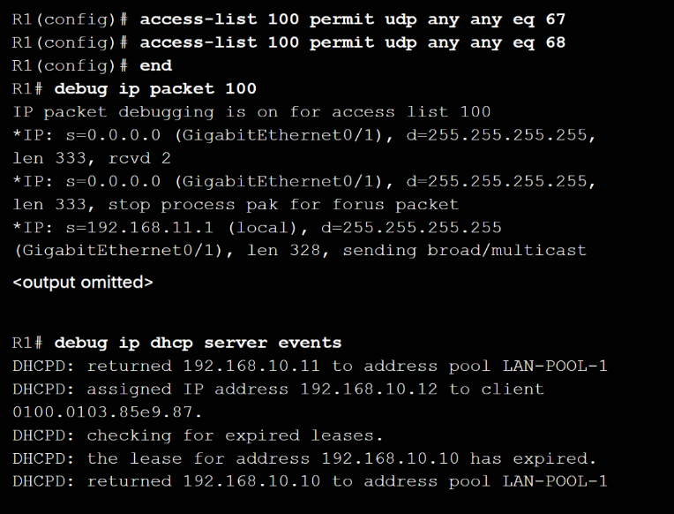
Troubleshoot DHCPv4 Debugging DHCPv4
The extended ACL is used with the debug ip packet command to display only DHCPv4 messages.
Another troubleshooting command is the debug ip dhcp server events.
Notes:
8.1 – DHCPv4
8.1.4 – Troubleshoot DHCPv4
8.1.4.3 – Debugging DHCPv4

Slide 30
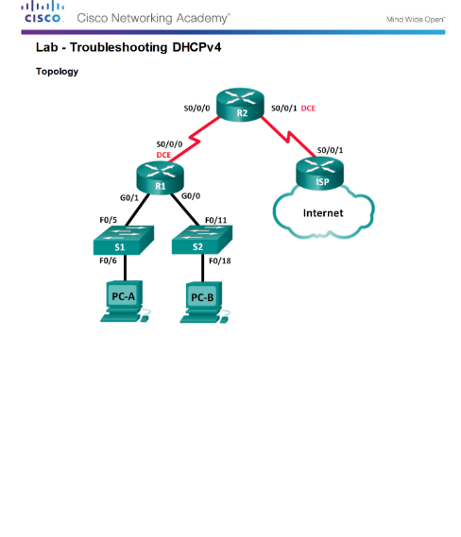
Troubleshoot DHCPv4 Lab - Troubleshooting DHCPv4
Notes:
8.1 – DHCPv4
8.1.4 – Troubleshoot DHCPv4
8.1.4.4 – Lab - Troubleshooting DHCPv4

Slide 31
8.2 DHCPv6
Notes:
8 - DHCP
8.2 – DHCPv6

Slide 32
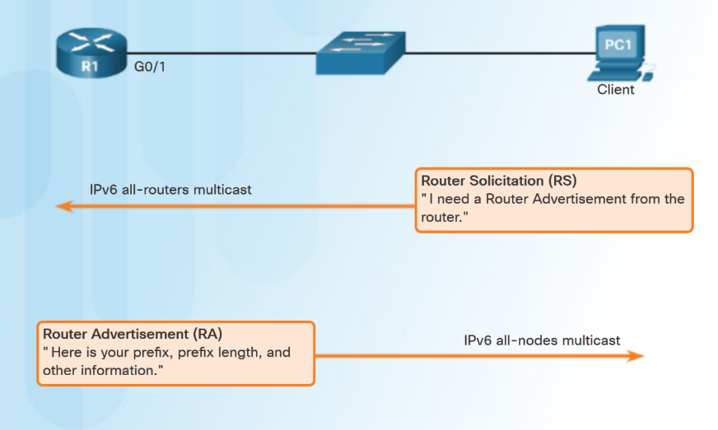
SLAAC and DHCPv6 Stateless Address Autoconfiguration (SLAAC)
Two methods to dynamically assign IPv6 global unicast addresses:
Stateless Address Autoconfiguration (SLAAC).
Dynamic Host Configuration Protocol for IPv6 (Stateful DHCPv6).
SLAAC uses ICMPv6 Router Solicitation and Router Advertisement messages to provide addressing and other configuration information.
Notes:
8.2 – DHCPv6
8.2.1– SLAAC and DHCPv6
8.2.1.1 – Stateless Address Autoconfiguration (SLAAC)

Slide 33
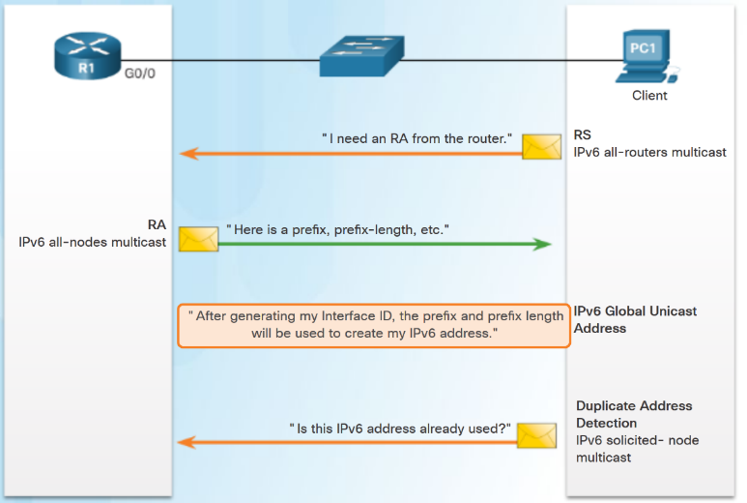
SLAAC and DHCPv6 SLAAC Operation
The router must have IPv6 routing enabled– ipv6 unicast-routing
PC1 sends an RS message to the all-routers multicast address that it needs an RA.
R1 responds with an RA message that has the prefix and prefix length of the network.
PC1 uses this information to create its IPv6 global unicast address. It creates its interface id using EUI-64 or randomly generates it.
PC1 must verify that the address is unique by sending an ICMPv6 Neighbor Solicitation message.
Notes:
8.2 – DHCPv6
8.2.1– SLAAC and DHCPv6
8.2.1.2 – SLAAC Operation

Slide 34
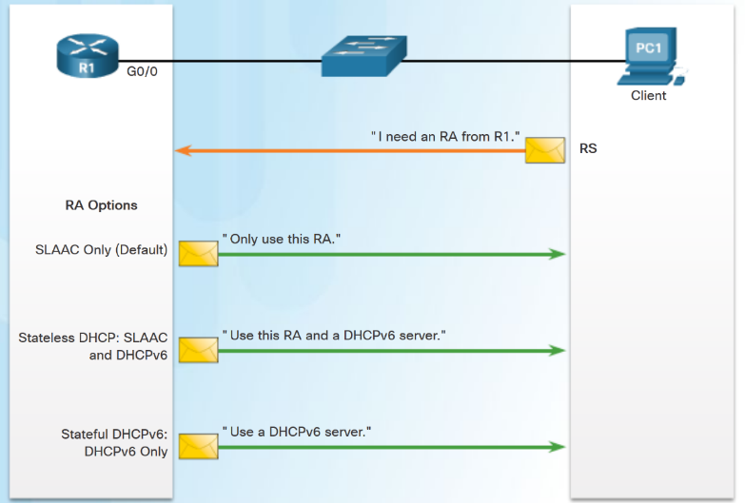
SLAAC and DHCPv6 SLAAC and DHCPv6
Different combinations of the Managed Address Configuration flag (M flag) and the Other Configuration flag (O flag) in the RA determine how the IPv6 address is assigned:
SLAAC (Router Advertisement only)
Stateless DHCPv6 (Router Advertisement and DHCPv6)
Stateful DHCPv6 (DHCPv6 only)
Notes:
8.2 – DHCPv6
8.2.1– SLAAC and DHCPv6
8.2.1.3 – SLAAC and DHCPv6

Slide 35
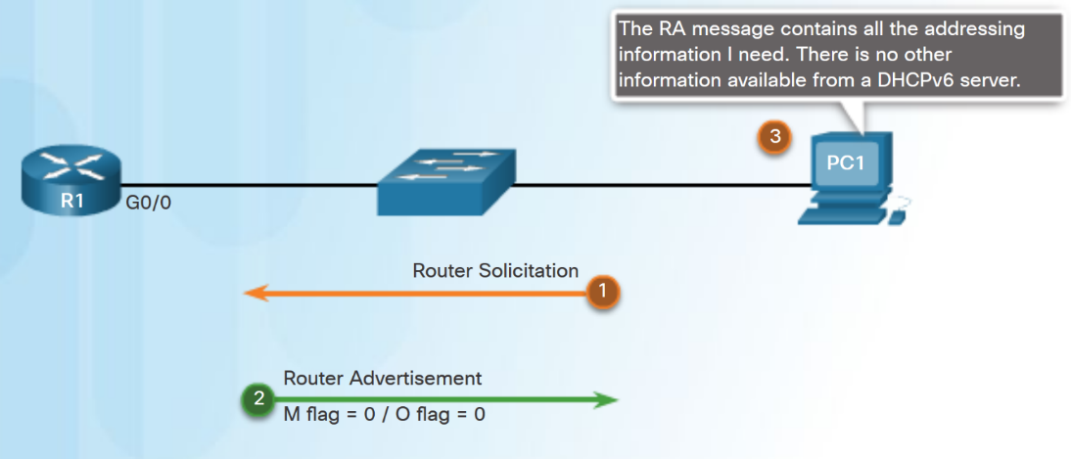
SLAAC and DHCPv6 SLAAC Option
SLAAC is the default on Cisco routers. Both the M flag and the O flag are set to 0 in the RA.
This option instructs the client to use the information in the RA message only.
Notes:
8.2 – DHCPv6
8.2.1– SLAAC and DHCPv6
8.2.1.4 – SLAAC Option

Slide 36
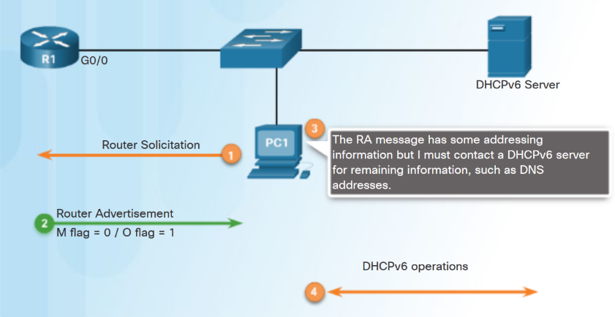
SLAAC and DHCPv6 Stateless DHCPv6 Option
DHCPv6 is defined in RFC 3315.
Stateless DHCPv6 option - client uses the RA message for addressing, additional parameters are obtained from DHCPv6 server.
O flag is set to 1 and the M flag is left at the default setting of 0. Use command ipv6 nd other-config-flag.
Notes:
8.2 – DHCPv6
8.2.1– SLAAC and DHCPv6
8.2.1.5 – Stateless DHCPv6 Option

Slide 37
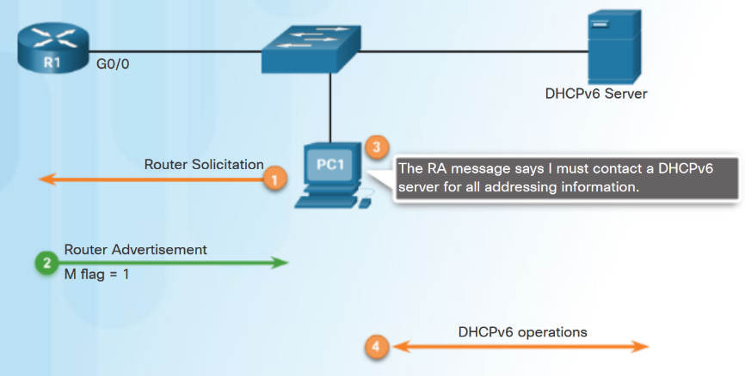
SLAAC and DHCPv6 Stateful DHCPv6 Option
RA message informs the client not to use the information in the RA message.
All addressing and configuration information must be obtained from a stateful DHCPv6 server.
M flag is set to 1. Use the command ipv6 nd managed-config-flag.
Notes:
8.2 – DHCPv6
8.2.1– SLAAC and DHCPv6
8.2.1.6 – Stateful DHCPv6 Option

Slide 38
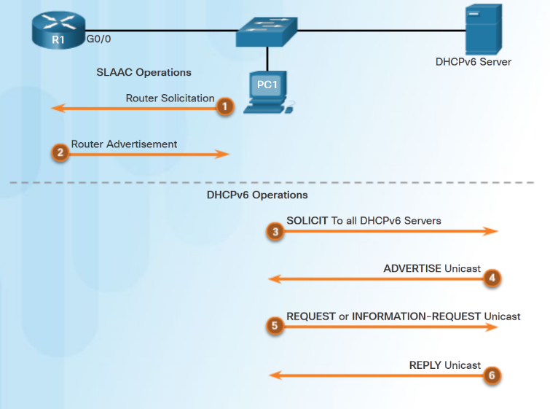
SLAAC and DHCPv6 DHCPv6 Operations
DHCPv6 messages from server to client use UDP port 546. Client to server use UDP port 547.
Client sends a DHCPv6 SOLICIT message using FF02::1:2.
DHCPv6 server responds with a DHCPv6 ADVERTISE unicast message.
Stateless DHCPv6 client - Generates its own address. Sends a DHCPv6 INFORMATION-REQUEST to the DHCPv6 server requesting only configuration parameters.
Stateful DHCPv6 client - Sends a DHCPv6 REQUEST message to server for an IPv6 address and all other configuration parameters.
Notes:
8.2 – DHCPv6
8.2.1– SLAAC and DHCPv6
8.2.1.7 – DHCPv6 Operations

Slide 39
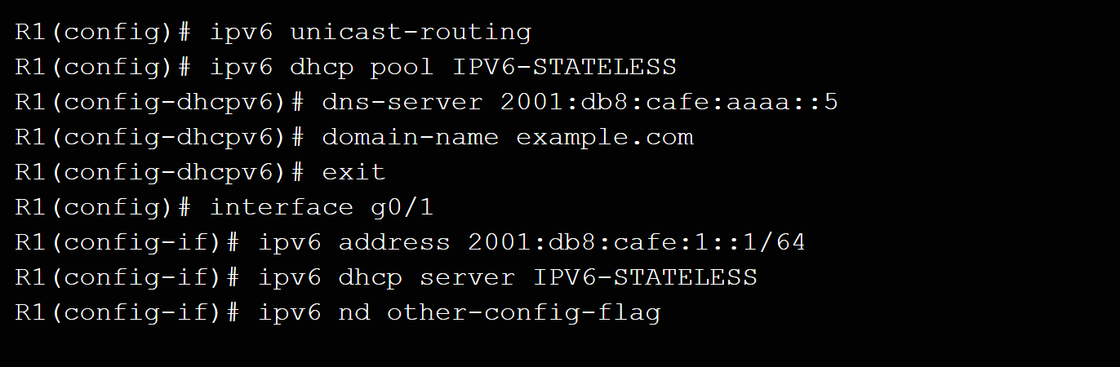
Stateless DHCPv6 Configuring a Router as a Stateless DHCPv6 Server
Step 1 – Enable IPv6 routing. ipv6 unicast-routing
Step 2 – Configure a DHCPv6 pool. ipv6 dhcp pool pool-name
Step 3 – Configure pool parameters. dns-server server-address
Step 4 – Configure the DHCPv6 interface ipv6 dhcp server pool-name
Notes:
8.2 – DHCPv6
8.2.2– Stateless DHCPv6
8.2.2.1 – Configuring a Router as a Stateless DHCPv6 Server

Slide 40
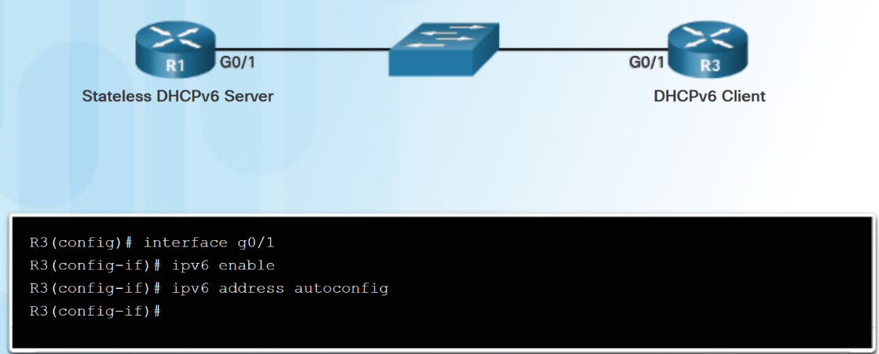
Stateless DHCPv6 Configuring a Router as a Stateless DHCPv6 Client
Step 1 – IPv6 enabled on interface ipv6 enable
Step 2 – enable automatic configuration of IPv6 addressing ipv6 address autoconfig
Notes:
8.2 – DHCPv6
8.2.2– Stateless DHCPv6
8.2.2.2 – Configuring a Router as a Stateless DHCPv6 Client

Slide 41
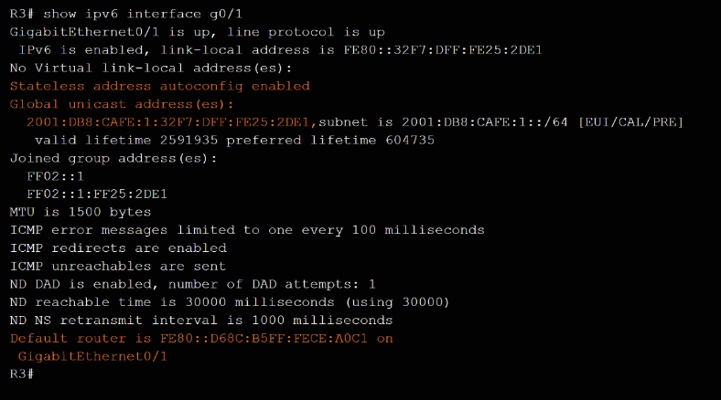
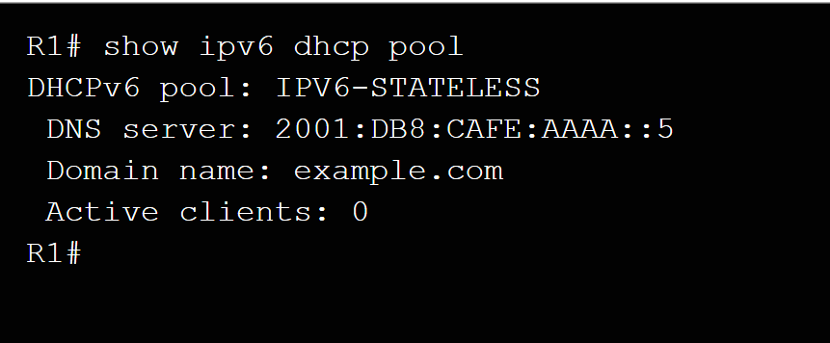
Stateless DHCPv6 Verifying Stateless DHCPv6
Commands to verify Stateless DHCPv6:
show ipv6 dhcp pool
show running-config
show ipv6 interface
debug ipv6 dhcp detail
Notes:
8.2 – DHCPv6
8.2.2– Stateless DHCPv6
8.2.2.3 – Verifying Stateless DHCPv6

Slide 42
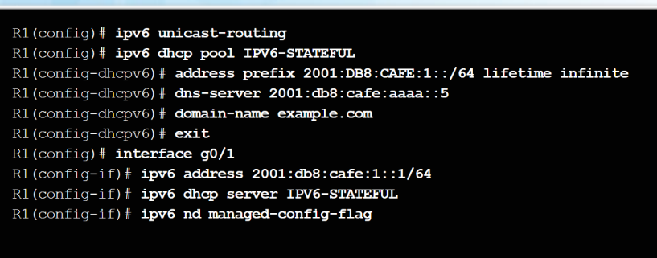
Stateful DHCPv6 Server Configuring a Router as a Stateful DHCPv6 Server
Step 1 – Enable IPv6 Routing.
ipv6 unicast routing
Step 2 – Configure a DHCPv6 pool.
ipv6 dhcp pool pool-name
Step 3 – Configure pool parameters:
address prefix prefix/length
dns-server dns-server-address
domain-name domain-name
Step 4 - Configure DHCPv6 interface:
ipv6 dhcp server pool-name
ipv6 nd managed-config-flag
Notes:
8.2 – DHCPv6
8.2.3– Stateful DHCPv6 Server
8.2.3.1 – Configuring a Router as a Stateful DHCPv6 Server

Slide 43
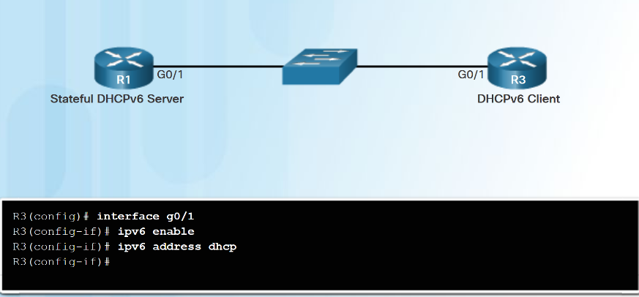
Stateful DHCPv6 Server Configuring a Router as a Stateful DHCPv6 Client
Step 1 – Allow the router to send RS messages and participate in DHCPv6.
ipv6 enable
Step 2 – Make the router a DHCPv6 client.
ipv6 address dhcp
Notes:
8.2 – DHCPv6
8.2.3– Stateful DHCPv6 Server
8.2.3.2 – Configuring a Router as a Stateful DHCPv6 Client

Slide 44
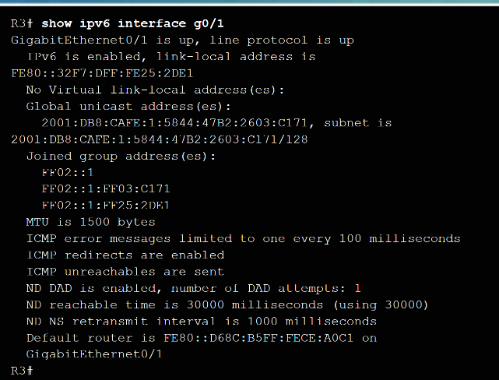
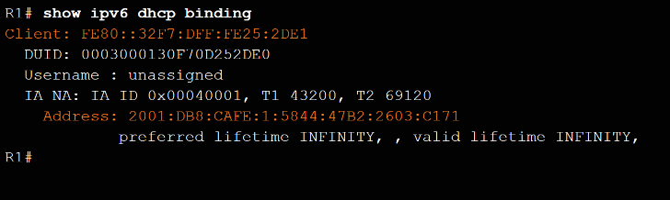
Stateful DHCPv6 Server Verifying Stateful DHCPv6
Use the following commands to verify Stateful DHCPv6:
show ipv6 dhcp pool
show ipv6 dhcp binding
show ipv6 interface
Notes:
8.2 – DHCPv6
8.2.3– Stateful DHCPv6 Server
8.2.3.3 – Verifying Stateful DHCPv6

Slide 45
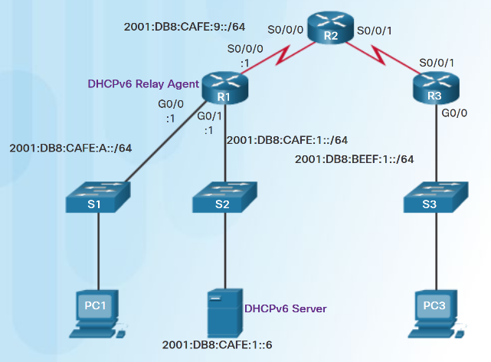
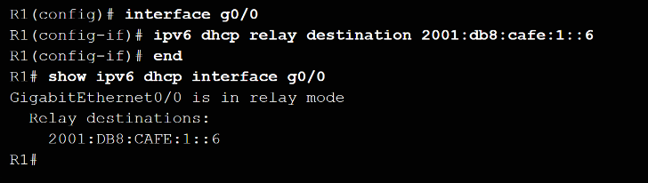
Stateful DHCPv6 Server Configuring a Router as a DHCPv6 Relay Agent
If the DHCPv6 server is located on a different network than the client, the router can be configured as a DHCPv6 relay agent.
ipv6 dhcp relay destination destination-address
Notes:
8.2 – DHCPv6
8.2.3– Stateful DHCPv6 Server
8.2.3.4 – Configuring a Router as a DHCPv6 Relay Agent

Slide 46
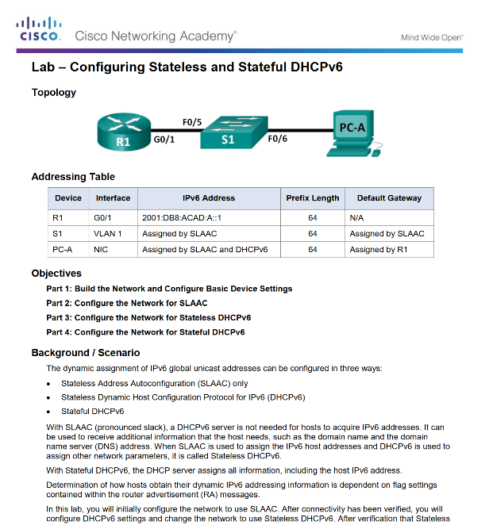
Stateful DHCPv6 Server Lab - Configuring Stateless and Stateful DHCPv6
Notes:
8.2 – DHCPv6
8.2.3– Stateful DHCPv6 Server
8.2.3.5 – Lab - Configuring Stateless and Stateful DHCPv6

Slide 47
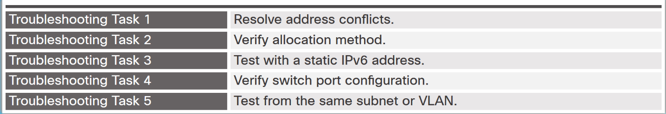
Troubleshoot DHCPv6 Troubleshooting Tasks
Notes:
8.2 – DHCPv6
8.2.4– Troubleshoot DHCPv6
8.2.4.1 – Troubleshooting Tasks

Slide 48
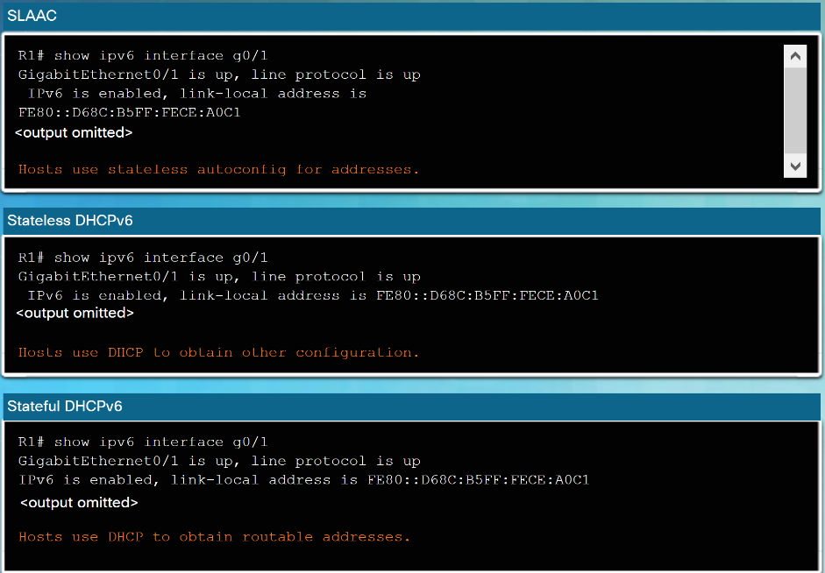
Troubleshoot DHCPv6 Verify Router DHCPv6 Configuration
Use the show ipv6 interface command to verify DHCPv6 configuration.
Notes:
8.2 – DHCPv6
8.2.4– Troubleshoot DHCPv6
8.2.4.2 – Verify Router DHCPv6 Configuration

Slide 49
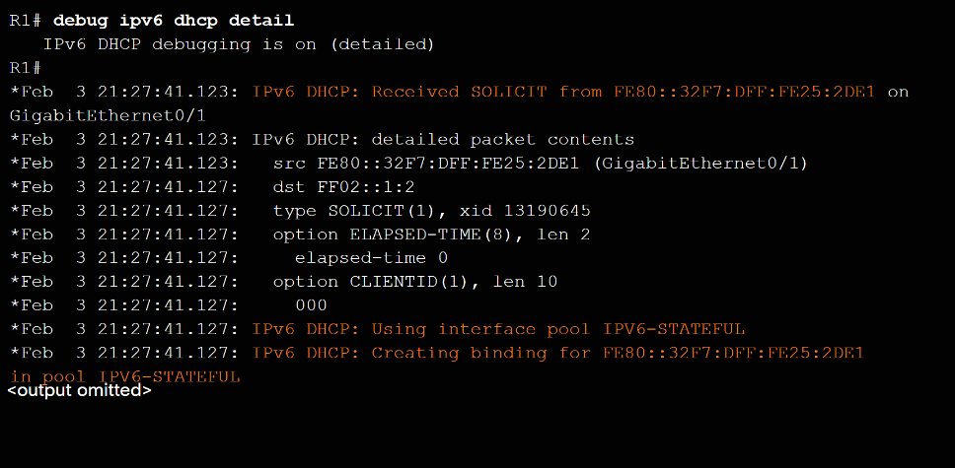
Troubleshoot DHCPv6 Debugging DHCPv6
To verify the receipt and transmission of DHCPv6 messages:
debug ipv6 dhcp detail
Notes:
8.2 – DHCPv6
8.2.4– Troubleshoot DHCPv6
8.2.4.3 – Debugging DHCPv6

Slide 50
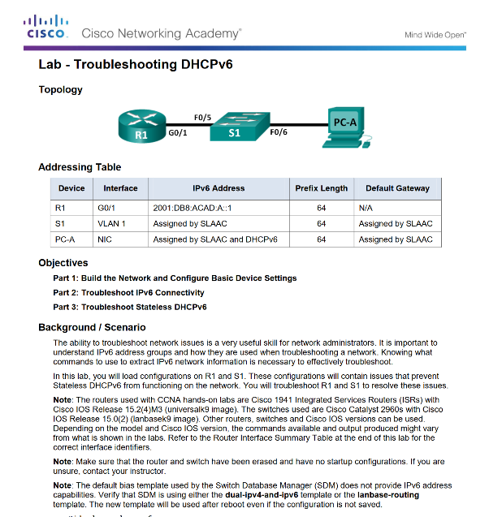
Troubleshoot DHCPv6 Lab - Troubleshooting DHCPv6
Notes:
8.2 – DHCPv6
8.2.4– Troubleshoot DHCPv6
8.2.4.4 – Lab - Troubleshooting DHCPv6

Slide 51
8.3 Chapter Summary
Notes:
8 - DHCP
8.3 – Chapter Summary

Slide 52
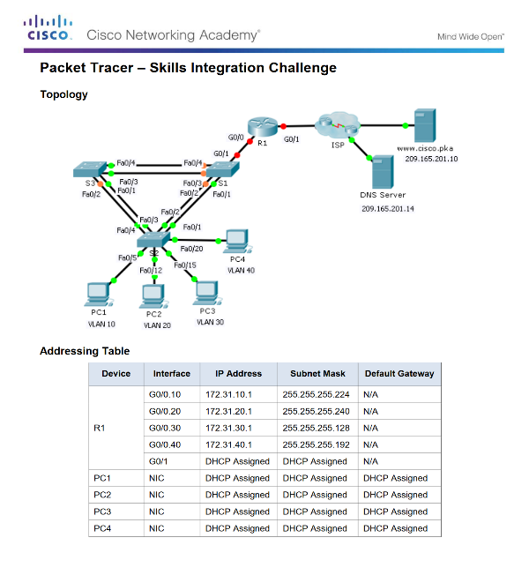
Conclusion Packet Tracer - Skills Integration Challenge
Notes:
8.3 – Summary
8.3.1 – Conclusion
8.3.1.1 – Packet Tracer - Skills Integration Challenge

Slide 53
Conclusion Chapter 8: DHCP
Implement DHCPv4 to operate across multiple LANs in a small to medium-sized business network.
Implement DHCPv6 to operate across multiple LANs in a small to medium-sized business network.
Notes:
8.3 – Summary
8.3.1 – Conclusion
8.3.1.3 – Chapter 8: DHCP

Slide 54
Chapter 8 New Terms and Commands
Dynamic Host Configuration Protocol (DHCP) DHCPv4 DHCPv6 lease DHCPDISCOVER message DHCPOFFER message DHCPREQUEST message DHCPACK message DHCP Options client IPv4 address (CIADDR) default gateway address (GIADDR) Cisco IOS helper address DHCPv4 relay agent | Stateless Address Autoconfiguration (SLAAC) stateless DHCPv6 server stateful DHCPv6 server Internet Control Message Protocol version 6 (ICMPv6) Router Solicitation (RS) message Router Advertisement (RA) message Interface ID (IID) EUI-64 Neighbor Solicitation (NS) message solicited-node multicast address Neighbor Advertisement (NA) message | Duplicate Address Detection (DAD) Managed Address Configuration flag (M flag) Other Configuration flag (O flag) stateful DHCPv6 DHCPv6 SOLICIT message DHCPv6 ADVERTISE unicast message DHCPv6 REQUEST message DHCPv6 INFORMATION-REQUEST message Stateless DHCPv6 client Stateful DHCPv6 client DHCPv6 REPLY unicast message atelesunicast message
Dynamic Host Configuration Protocol (DHCP) DHCPv4 DHCPv6 lease DHCPDISCOVER message DHCPOFFER message DHCPREQUEST message DHCPACK message DHCP Options client IPv4 address (CIADDR) default gateway address (GIADDR) Cisco IOS helper address DHCPv4 relay agent | Stateless Address Autoconfiguration (SLAAC) stateless DHCPv6 server stateful DHCPv6 server Internet Control Message Protocol version 6 (ICMPv6) Router Solicitation (RS) message Router Advertisement (RA) message Interface ID (IID) EUI-64 Neighbor Solicitation (NS) message solicited-node multicast address Neighbor Advertisement (NA) message | Duplicate Address Detection (DAD) Managed Address Configuration flag (M flag) Other Configuration flag (O flag) stateful DHCPv6 DHCPv6 SOLICIT message DHCPv6 ADVERTISE unicast message DHCPv6 REQUEST message DHCPv6 INFORMATION-REQUEST message Stateless DHCPv6 client Stateful DHCPv6 client DHCPv6 REPLY unicast message
Notes:
New Terms and Commands

